Slide 1
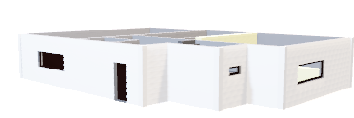
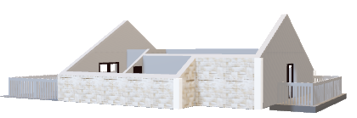
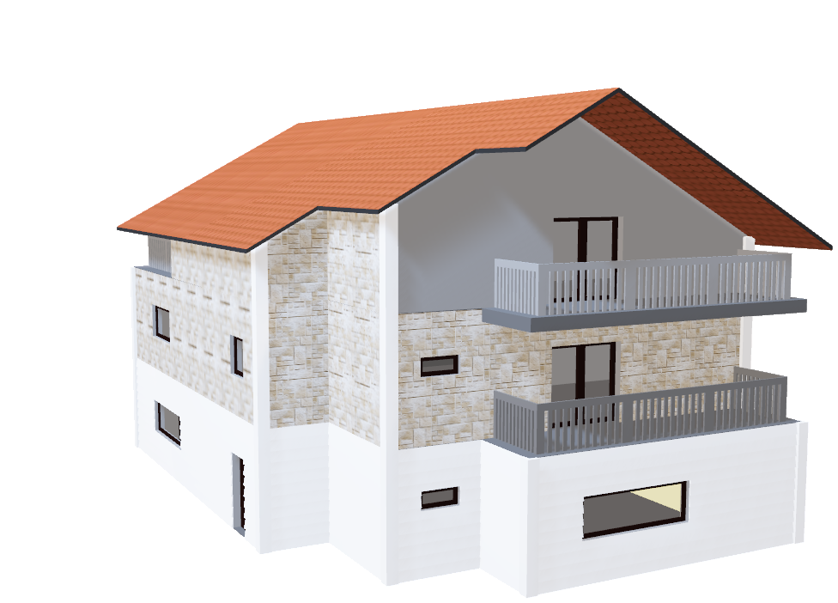
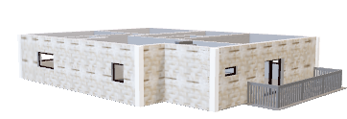
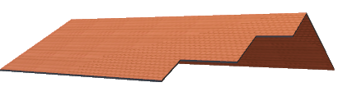
FABRIKAM RESIDENCES PRESENTS: THE ULTIMATE IN MODERN LIVING
In a world where downtime is more wishful thinking than reality, it’s essential that your home offers true tranquility, space, and comfort.
Introducing the utmost in luxury living:
THE ROSARIO
Designed to make the most of natural light, with soaring ceilings, 8ft doors, and spacious enough for the largest of families, this really is a place where your home really can be your castle.

Slide 2
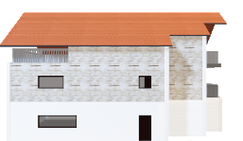
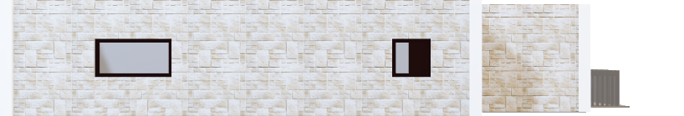
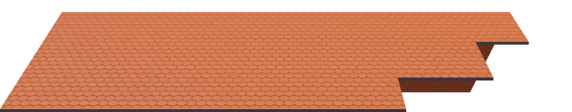

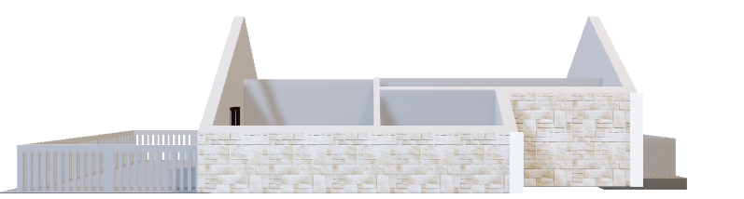
FRONT
ROOF:
Dazzling Mediterranean Roman style roof tiles
3rd FLOOR:
Natural stone complements the surrounding environment
2nd FLOOR:
Strategic window placement for an aesthetically pleasing exterior
1st FLOOR:
Whitewashed exterior provides a contemporary, yet classical, finish

Slide 3
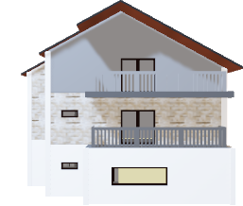
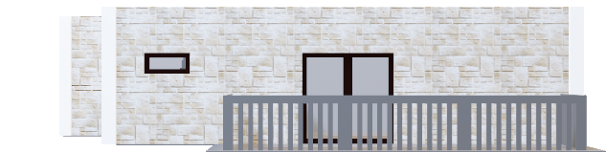


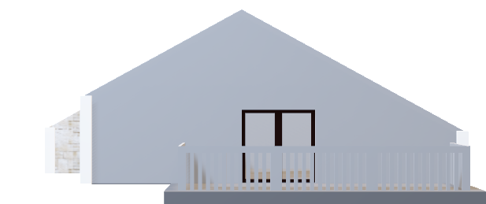
SIDE
ROOF:
Stepped rear design offers attractive viewing profile
3rd FLOOR:
Large terrace finished in cool grey for the perfect neutral effect
2nd FLOOR:
Stone tiling is delightfully accompanied by soft grey tones
1st FLOOR:
Panoramic window allows natural light to flow into the house

Slide 4
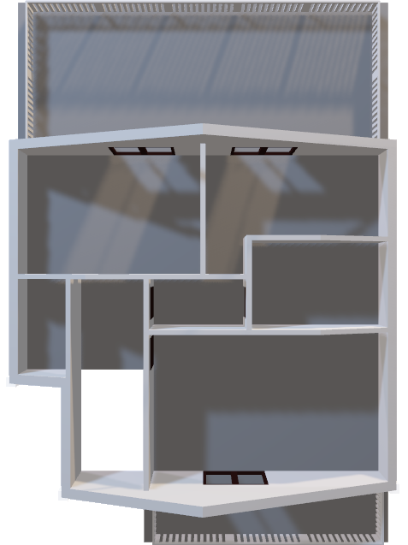
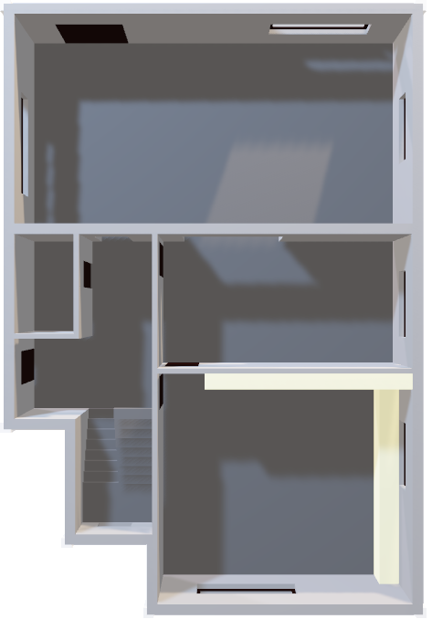
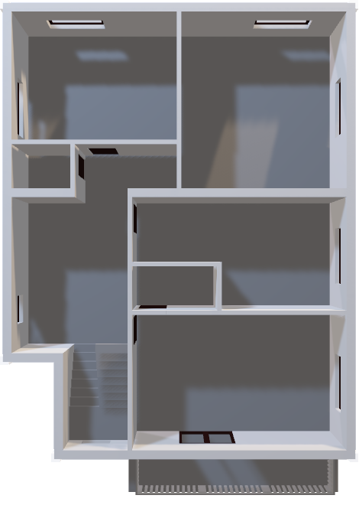
EXPERTLY DESIGNED TO MAKE THE MOST OF EVERY INCH OF SPACE, PROVIDING LUXURY LIVING FOR THE LARGE OR GROWING FAMILY
3RD FLOOR
2ND FLOOR
1ST FLOOR

Slide 5

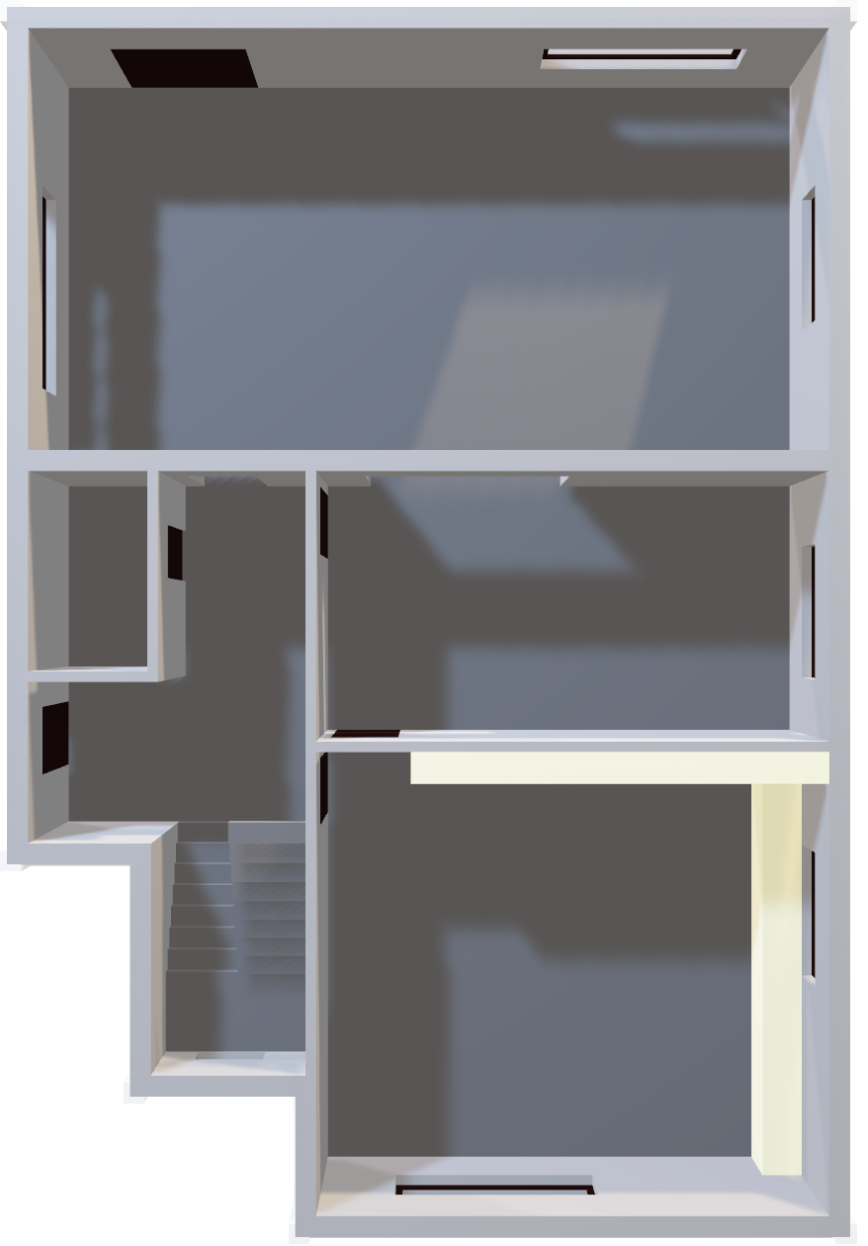
1ST FLOOR
Roof
A vast living/family room with large window for that all-important natural light. Spacious dining room with convenient access from large kitchen. Top quality, bespoke kitchen units incorporating the latest technology and luxury materials. Expansive hallway and downstairs cloakroom.
3rd Floor
2nd Floor

Slide 6
LARGE, SPACIOUS ROOMS ON EACH LEVEL PROVIDE THE UNIQUE OPPORTUNITY FOR ALL THE FAMILY TO HAVE THEIR OWN PERSONAL SPACE
Roof
3RD FLOOR
2ND FLOOR
1ST FLOOR

Slide 7
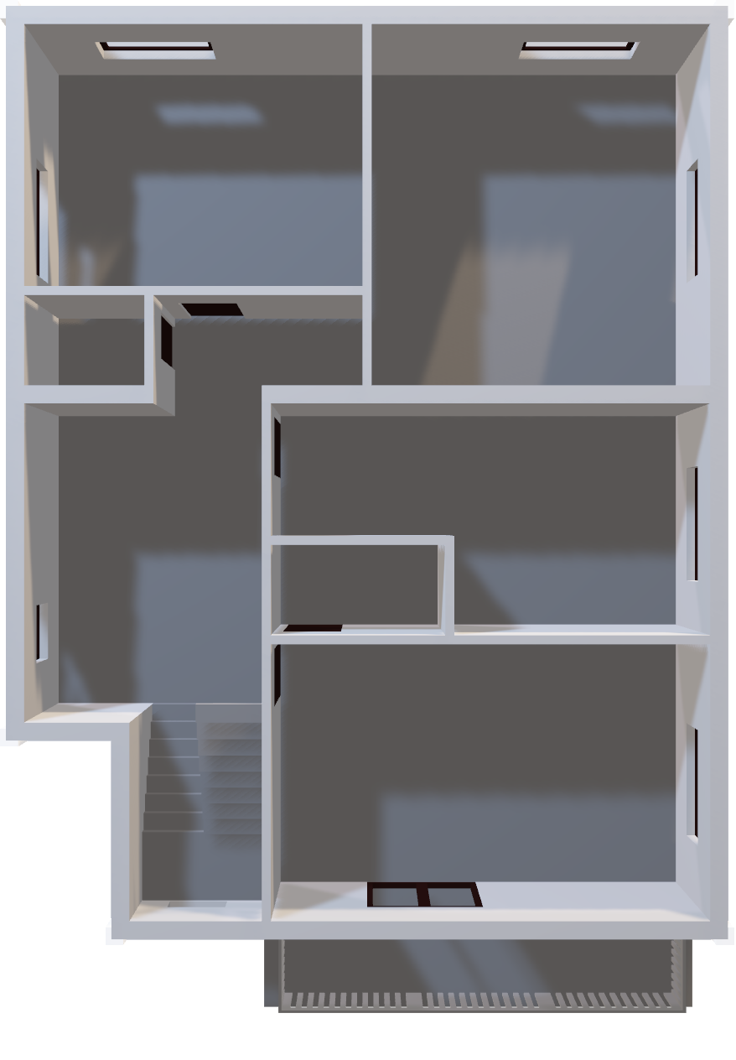

2ND FLOOR
Roof
Boasts three great sized bedrooms, the first with double doors leading to a balcony, and the others offering large windows to benefit from wonderful natural light. The family bathroom provides bathtub and separate shower unit, and is furnished to the highest of your personalized specifications
3rd Floor
1st Floor

Slide 8
MULTIPLE CHOICES FOR LIVING SPACE, INCLUDING AN OWNERS' SUITE, COMPRISING MASTER BEDROOM, EN-SUITE, AND DEN/STUDY
Roof
3RD FLOOR
2ND FLOOR
1ST FLOOR

Slide 9

3RD FLOOR
Roof
The crowning glory of this gorgeous living space; the top floor master bedroom suite with all associated amenities. Boasts two balconies–ideal for an alfresco breakfast in the morning sun. Vaulted ceilings and clean lines in the freshest of white finishes makes this upper area a true haven of peace and tranquility.
2nd Floor
1st Floor

